Slide 1


OCI Identity & Access Management
Introduction and Overview
Alexandre Fagundes
Cloud Architect | Oracle Latin America
Notes:
Introduction and Overview Presentation on OCI IAM
Hello and welcome. Thank you for your time today. I’m happy to be here.
---
Presenter Notes:
We provided an embedded script (in the slide notes) to help you get comfortable with the presentation flow and content. But we encourage you to use your own words as you grow comfortable and to customize the presentation as appropriate for you (the presenter) and the audience.
If you plan to use the embedded script, some slides have notes after the script portion that encourage dialog with your audience. Interactive discussions tend to yield better results because your learning about the customer’s needs as you go AND because it helps prevent the audience from getting distracted and tuning out for portions of the presentation.
On slides that build, “[click]” indicates the moment in the script to mouse-click to advanced the slide build.
If you are going to share this presentation with customers, please SAVE AS PDF which will REMOVE THE SCRIPT. The slide content should be enough to serve as a reminder of the conversation and the service’s capabilities.

Slide 2
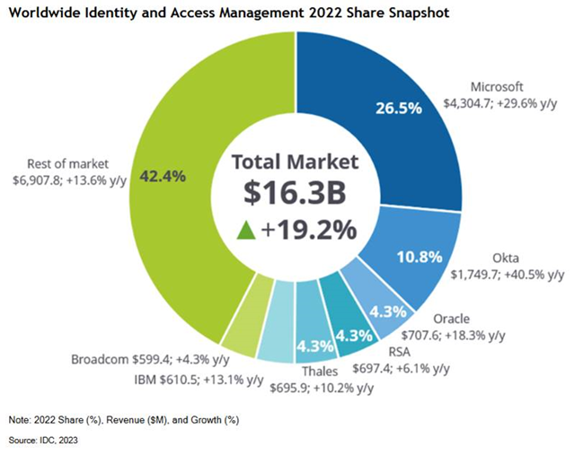
IDC Worldwide IAM Market Shares, 2022 (June 2023)
Notes:
Source: IDC Worldwide Identity and Access Management Market Shares, 2022: CIAM Grows Fastest
June 2023

Slide 3
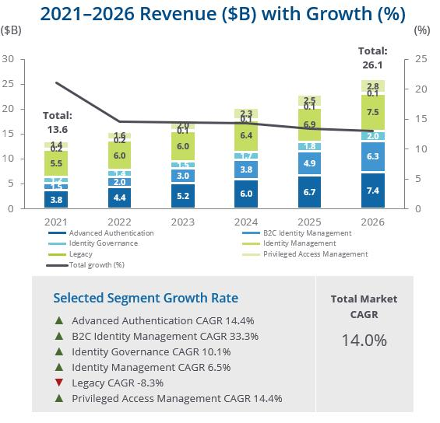
IDC Worldwide Identity and Access Management Forecast
Key Advice for Technology Suppliers
Half the total market will be placing long-term bets in the next two to three years as they migrate away from clunky on-premises systems and replace inadequate homegrown solutions.
Add AI/ML technology everywhere it makes sense, driving value from risk-based analytics… Pinpoint where people are involved and strive to replace them with supervised logic.
(full section text in slide notes)
23.0
17.8
20.3
15.5
Notes:
Source: IDC, Worldwide Identity and Access Management Forecast, 2022–2026: Lead, Follow, or Get Out of the Way, #US48670522
Advice for Technology Suppliers
Develop a plan to be a bigger player that eventually defines a full software platform. CISOs are tired of piecemealing something together from four or more different vendors and will increasingly be attracted to those that can provide access, privilege, and governance. IDC believes maybe half the total market will be placing long-term bets in the next two to three years as they migrate away from clunky on-premises systems and replace inadequate homegrown solutions. Bad identity solutions cause stress among employees and partners and are just outright bypassed by consumers.
Develop a strong IDaaS solution that can also work on premises for the minority of use cases that will still exist five years from now. Several of the most feature-rich platforms are still stronger on premises than in the cloud; no wonder, they've been operating there for decades, and the innovator's dilemma is to serve the needs of the installed base rather than prepare for a next phase. That next phase will be IDaaS, or you're aiming at a niche (wait for private equity to come calling if the code base is strong).
Add AI/ML technology everywhere it makes sense, driving value from risk-based analytics. Identity has always been a pain; changes to identity systems will certainly be a pain. Data is pretty abundant, but how can that analysis be supplied to reduce the manual labor element (definitions and approvals) of identity security? Any ROI study documents that the biggest savings associated with an IT technology purchase is the reduction in head count. Pinpoint where people are involved and strive to replace them with supervised logic.
Consider adding/acquiring a secrets management solution to secure your future position as an identity supplier. Even today, there are more "things" than people operating within your networks. Successful identity management vendors are going to need to provide access and monitor machine-to-machine interactions as much as they do people. A thing can cause a lot of damage in short order when it's compromised. It is a bit of a different game, but there are numerous requirements that can leverage core identity components. Don't be the vendor that fails to check the things box on the RFP for worldwide conglomerate XYZ.

Slide 4

20+ years of leadership in IAM
Notes:
Oracle has been in the IAM space since the beginning. We have more experience than anyone solving big, difficult Identity and Access Management challenges for the world’s largest, most complex organizations. Our global partner ecosystem includes the biggest names and covers the broadest geographies. Our world-class support organization provides support that follows the sun (24x7) and offers customer assistance in most local languages. And our native deployment across OCI allows us to support local deployments with adherence to data residency requirements in more global regions than any other IAM solution provider.
This is a critical era for those of us in the IAM space. Not only because the technology has changed or because the challenge is more complex than ever – but because our technologies (IAM), the tools that we all use day-to-day, are finally being recognized for their importance. I’m sure you’ve heard “identity is now the perimeter” - I’ll talk next about what that means.
---
1:00
10:00 (section)

Slide 5


There’s a high-pressure system developing…
Zero Trust
Assume Breach
Distributed IT across on-prem, SaaS, and multiple clouds.
User credentials among top targets for hackers.
IAM is too complex to manage; there are multiple IAM silos.
Distributed stakeholders with limited control over devices, networks, etc.
Lack of visibility across 100’s of apps that may include shadow IT
IAM is the New Perimeter
Notes:
To use a brief weather analogy – there’s a high-pressure system developing…
Distributed IT across on-prem, SaaS, and multiple clouds. We call this “hybrid IT” or the “extended enterprise”.
Stakeholders (employees, partners, and customers) are also distributed and we have limited control over what devices they use, what networks they expose themselves to, or any other potentially poor security practices.
User credentials remain among the top targets for hackers. The right credentials help establish a foothold and could quickly become keys to the kingdom. We know that account phishing and privilege escalation are among the top techniques used in cyber-attacks.
We lack visibility across the hundreds of applications deployed across our orgs. Many were purchased directly by lines of business with no security oversight. We don’t always know what data is being accessed and by who?
IAM is often described as too complex to manage across all of these environments and use-cases; There are probably multiple IAM silos in your environment. And it’s probably really difficult to answer simple questions like: “who has access to what?” and “how is that access being granted?”
Complexity is the enemy of security. All of this complexity increases risk and reduces our ability to respond to security and regulatory audits.
High pressure systems are not good for clouds.
So what can you do?
[click] – Zero Trust: Always explicitly verify the user. Don’t assume that they’re who they claim to be, just based on a device or network.
Enforce Least Privilege so that there are no permissions hanging out there that could be exploited (unless they’re needed).
[click] – Assume Breach: We know breaches happen. There are a million ways into your network, and you don’t even need to be the intended target. Many attacks are scripted, automated, and just sprayed widely hoping that some employee somewhere will click a link, open an attachment, or plug-in a free USB drive. Assume a piece of malware will be able to impersonate one of your employees. What will it be able to do? What data can it reach? Will it trigger any alarms?
[click] – And think of IAM as the New Perimeter: Instead of configuring firewalls to allow or deny access at the perimeter, we need IAM to play that role - at the point of access. If someone needs access to a high-value target or some app or asset that’s high-risk, you can grant a permission, but understand the risk, govern that access, and monitor how it’s being used.
So, this is the backdrop for where we are with Identity & Access Management today. This is the field-of-play that we find ourselves on. What can we do?
You’ll see some common themes for our IAM solutions, as we look forward:
Simplicity: How can we reduce complexity associated to Identity and Access Management?
Visibility: How can we improve your visibility into the broad set of apps and users, wherever they are?
Automation: How can we help you identify risk among all the confusion? It’s not enough to have people periodically review access. You’ll want more automation to identify areas of risk - continuously; and in some cases, to remediate as well.
Ultimately, we want to weave an Identity and Access fabric throughout all of your infrastructures, platforms, and apps - to create a single, unified view into access and related risk. We want to make IAM easy to manage.
---
3:30

Slide 6
Oracle Identity & Access Management Portfolio
Strong and Adaptive Authentication
Access
Management
Identity
Store
Lifecycle Management
Access
Governance
Oracle Cloud Identity Platform
OCI IAM
Access Governance
Oracle IAM Suite
Oracle Access Management
Oracle Directory Services
Oracle Identity Governance
Oracle Identity Role Intelligence
Notes:
This is just a quick visual of our full IAM portfolio:
You can see the IAM segments where we focus: strong and adaptive authentication, access management, identity store, lifecycle management, and access governance. And there are two parallel deployment tracks:
The Cloud Identity Platform includes the OCI IAM service which is a full-featured IDaaS solution for workforce, consumer, and developer scenarios. And we recently introduced a cloud-native Access Governance service.
And the traditional Oracle IAM Suite doesn’t look so traditional anymore. We’ve addressed the big issues around deployment complexity and upgrades by making it really easy to deploy via Kubernetes and by re-architecting the backend piece-by-piece using microservices. Cloud seems to have all the buzz but we’re continuing to invest here because our customers continue to ask for it.
So,
Organizations have choice of deployment and consumption models to provide those key IAM functions.
And Oracle customers can continue with existing investments or modernize via either track.
A cloud-native SaaS-delivered IAM platform. Or -
The suite offering containerized deployments available on any cloud.
All of these solutions work together and with third-party IAM via native integrations, open standards, and APIs.
And both deployment tracks support IAM for apps that may live on-prem or in the cloud – they both support Hybrid IAM.
BTW, OCI IAM is the new branding for Oracle Identity Cloud Service (IDCS). IDCS has been merged into OCI IAM and adopted the OCI branding. So, we now have a single, unified IDaaS service that includes all the functionality of IDCS as well as that of the previous version of OCI IAM.
So, customers can choose either of these or a hybrid combination when architecting their own IAM deployment.
---
2:00

Slide 7



OCI
Identity and Access Management
Oracle Cloud Applications
Oracle Cloud Infrastructure
Complete suite of integrated applications
Secure, high-performance platform for all your workloads
7
Copyright © 2024, Oracle and/or its affiliates
Notes:
I talked earlier about the general climate – the pressure that we’re all facing in the security space to deal with distributed IT, lack of control over user behavior, the importance of user credentials, and identity and access in general.
Oracle feels this pressure as much as anyone. In addition to helping customers, we’ve gone through our own massive transformation to rebuild Oracle for the cloud. We’ve invested tremendously in two key areas:
Cloud Applications (SaaS-delivered business apps). This includes our Fusion apps on which companies run their business – ERP, HCM, SCM, Financials, etc. as well as 50 or 60 vertical-specific apps for utilities, energy, hospitality, retail, healthcare, and many others.
And a new, second-generation public Cloud Platform (Infrastructure and Platform services) – including compute, storage, database, analytics, integration services, and more. And of course, our apps run on our own cloud infrastructure.
In addition to other generational improvements, our cloud platform was designed to address many of the security shortcomings of the previous generation clouds. For example:
Access is always denied by default. You don’t have to configure security to lock it down.
Data and communications are always encrypted by default.
Compartments and Tagging make it easier to securely manage access to cloud resources.
We separated the cloud control plane from customer workloads, at the physical layer, for stronger isolation.
So, Oracle is primarily a cloud and SaaS company, and we’ve had to make sure that security is foundationally baked-in.
Identity plays a critical role in securing access to our Cloud Platform and Applications. One of the reasons we continue to invest heavily in the OCI IAM service is because, in addition to serving self-contained IAM use-cases (like we have for 20 years), we also serve as the front-door and the access control plane for Oracle Cloud and SaaS applications.
Our cloud IAM service is now completely aligned to Oracle’s key business objectives and growth areas. It has to be powerful, robust, secure, open, and flexible – to enable our broad customer base to meet their IAM-related business requirements.
When we merged IDCS into OCI IAM, we created a single OCI-native service with robust identity features and laid the foundation for innovation and improvements to address the complexity and risk that are so commonly associated with IAM.
---
2:30

Slide 8









OCI IAM Identity Domains
Oracle is merging IDCS and OCI IAM services under the OCI IAM brand
OCI IAM will provide a single, unified IDaaS for Oracle and non-Oracle apps across hybrid cloud environments with robust MFA options, Adaptive Access, and Lifecycle Management
OCI
Apps
On-Prem Apps
3rd-Party Apps
Easier identity service management and config
Reduced architectural complexity
Simplified identity and access administration
Enhanced features for included tiers
Broader flexibility of use-cases
Improved OCI experience; single entry point
Unified view of access and risk
Unified platform for innovation and growth
OCI IAM
IDCS
Notes:
So, we now have a unified IAM service that addresses the needs of OCI, Oracle Apps, as well as third-party apps which may be SaaS, running in the cloud, or on-prem.
---
0:30
(This slide animates.)

Slide 9
Built for Scale and Performance
102K
Customer Accounts
450M
Identities
30+ Commercial regions globally
140K
Employees
4500
Applications
Oracle’s Internal Deployment
Notes:
The service is built for high scale and performance.
OCI IAM already manages over 100k customer accounts and 450M identities. We also went through our own internal process to adopt the service for our 140K employees with over 4500 applications onboarded.
---
0:30

Slide 10
OCI IAM Functional Overview
Notes:
Let’s take a high-level look at the OCI IAM service.
---
7:00

Slide 11
OCI Identity & Access Management (OCI IAM)
Key Functional Pillars
Enterprise Identity & Access Management for complex, hybrid IT environments
Access Control Plane for Oracle Cloud and SaaS applications
Developer-friendly IAM engine for custom and consumer applications
Notes:
OCI IAM provides three core functions– these are essentially the three problem areas we address:
First, it stands on its own as a holistic enterprise IAM platform providing everything an organization needs to manage user identities and access entitlements across Oracle and third-party platforms and services. While it’s a native OCI service, it reaches across other clouds and SaaS services and into on-prem environments to manage access and entitlements for (and to enable SSO to) all your critical enterprise applications. This obviously enables quick productivity and reduces the effort to meet security and compliance objectives related to Identity and Access.
It also serves as the control plane for Oracle - Cloud Infrastructure, Platform, and SaaS Applications - providing an integrated and seamless experience for both IAM administrators and end-users.
It provides a developer-friendly IAM engine making it easy to add identity and access functionality to custom and consumer-facing applications. This includes features like social logon, user self-service, consent management, and a fully customizable user experience. The service was designed API-first meaning that every bit of functionality is available programmatically – our consoles can be 100% customized or even replaced – and, more importantly, developers can embed IAM functionality directly into their apps without requiring users or administrators to hop between consoles.
OCI IAM delivers significant functionality across each of those pillars through a single, unified service.
---
Note: Use this moment to ask the customer questions about how they address these use-cases and/or which they’re looking to address.
---
1:30

Slide 12




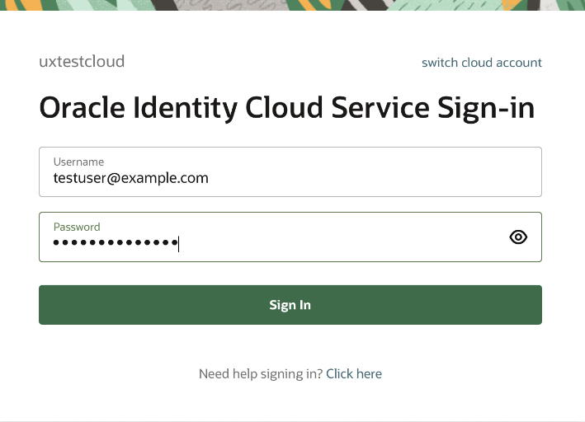

















OCI Identity & Access Management (OCI IAM)
Enterprise Identity & Access Management
OCI IaaS and PaaS
IAM Policies
***
External Id Providers
Social
Logon
Federated SSO
SaaS Apps
OCI IAM
Oracle Sign-In
External MFA Providers
Federated Logon
RADIUS
Proxy
VPN Clients
Oracle Databases
Outbound Authentication and SSO
MFA
Inbound Authentication and SSO
External Risk Providers
!
Linux PAM
Module
Linux Hosts
?
✓
Adaptive
Security
Identity Store and Lifecycle Management
Microsoft Active Directory
App
Gateway
Enterprise Apps
Active Directory
Bridge
Provisioning
Bridge
User & Access
Management
App Catalog
12
Copyright © 2024, Oracle and/or its affiliates
Notes:
Here, we’ll walk through the key capabilities of the OCI IAM service.
Inbound Authentication and SSO
Identity Store and Lifecycle Management
Oracle Cloud Authentication and Access Policies
Outbound Authentication and SSO
[click] Starting with Inbound Authentication and SSO – this is how users are authenticated into the service. We offer numerous methods including:
Inbound federation – either from other Identity Providers using federation protocols like SAML or OpenID Connect or - primarily in the case of consumer use-cases - from social providers like LinkedIn, Twitter, and other social accounts.
We also provide native authentication of course - with several options for Multi-Factor Authentication (MFA) including a mobile app with one-time-passwords or simple push to approve, we support common MFA methods like email, SMS, and phone calls, and more secure options such as FIDO-2 enabled hardware authenticators.
Adaptive Security allows us to evaluate session context in real time looking at factors such as: Is the user’s device trusted? What network or location are they coming from? And their recent behavior. And we use that telemetry to make decisions about whether to allow-or-deny access, or to step-up authentication to a stricter MFA mechanism.
For organizations who want to leverage Active Directory without moving AD credentials into the cloud service, we also support delegated authentication to AD via the AD Bridge component.
[click] Next, we’ll look at the Identity Store and Lifecycle Management – this is about getting user accounts into the service, managing their attributes, role and group memberships, assigning permissions, provisioning and deprovisioning accounts, automating the synchronization, and setting security policies.
Of course, you can manage users and entitlements directly in the console, but it’s also common for customers to want to automate account provisioning, deprovisioning, and entitlement management. We have several ways to do that.
We have many popular apps available in the app catalog that are pre-configured for provisioning.
We can automate account management from Active Directory using the AD Bridge.
You can use the Provisioning Bridge to manage accounts for virtually any enterprise apps that may be running on-prem or may be cloud-hosted but perhaps don’t support open standards. The Provisioning Bridge leverages ICF connectors which have been used for several years with Oracle Identity Manager so there’s a good amount of collective knowledge out there on how to interact with various applications.
And if you want to automate provisioning from another identity system or perhaps a Service Management (ITSM) system, you can leverage our APIs or the SCIM protocol to facilitate those types of integrations.
And we include user self-service capabilities for: registration and enrollment, AND management of profiles, passwords, and terms-of-use consent.
[click] For Outbound Authentication and SSO – after we know who the user is and what permissions they have, this is how we enable single sign-on to target applications.
We, of course, support open standards and protocols like SAML and OpenID Connect, but standards-based federation leaves out a lot of applications.
We have an App Gateway that enables SSO to enterprise apps, which may be running on-prem or in cloud-hosted environments, that do NOT support federation protocols. It supports HTTP header-based authentication.
For web apps that don’t support either of those options, we also offer password vaulting and form-fill to simplify the user experience.
We have a RADIUS proxy that allows authentication for Databases and VPN clients,
and we offer a Linux PAM module that supports SSO to Linux hosts running on OCI.
Finally, for customers using Oracle Cloud Infrastructure (OCI), OCI IAM policies – allow you to manage access to OCI resources like networking, compute, storage, and analytics.
In OCI, all permissions are denied by default. So, administrators must create policies to ALLOW access where appropriate.
OCI IAM provides a very simple policy syntax that’s easy to read and understand.
We also provide a wizard-like policy builder in the console that simplifies the creation of common security policies.
And OCI offers strong separation of duties (and easier security management) through the concepts of
(1) Compartments, which create security boundaries inside of OCI accounts and
(2) Tagging, which provides a flexible framework enabling organizations to group resources based on tags and then to assign permissions based on those tags.
Obviously, there’s much more information on those approaches in the OCI documentation.
---
5:00
Note: Use this moment to gauge the customer’s understanding of these approaches. Some will already understand common IAM concepts such as federation, password vaulting, and the use of proxies, bridges, and gateways. If your audience does not, perhaps use some of the more detailed slides.

Slide 13






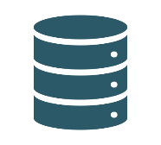
OCI Identity & Access Management (OCI IAM)
For Application Developers
OCI IDENTITY & ACCESS MANAGEMENT (IAM)
Social Logon
Adaptive Security
and MFA
Self-Registration
Self-Service
Terms of Use
Consent
OATH OAuth FIDO2 REST APIs SAML OIDC SCIM
Authentication Policies
and Configuration
Authentication and User Management
Fully Customizable User Interfaces
SDKs and Sample Code
Custom App
Notes:
OCI IAM was designed 100% API-First. Every feature or function available from the console is first available programmatically via APIs. This makes the admin console and user logon screens fully customizable (and/or even replaceable).
We provide sample code and SDKs to provide a very developer-friendly environment for adding Identity & Access features into custom and consumer-facing applications. Of course, we support social logon, various methods of strong and advanced authentication, user self-service for registration and password management, and user management of terms-of-use consent – all via open standards and protocols.
---
0:30
Note: If the customer is interested in developer use-case, use this moment to ask about their development platform. What languages do they use? Which SDKs would be most helpful? Are they familiar with social logon and consent management? What tasks do they want to accomplish programmatically?

Slide 14





Getting Started with OCI IAM
OCI Account
All access is denied by default except Administrators (full access).
Use Administrator to configure the OCI account; then protect it.
Access Policies
Administrators
Group
Compartment 1
Compartments provide security boundaries within accounts.
Organize access by resource type, business unit, or project.
Policies support tag-based access control for groups and/or resources
A default identity domain provides an IAM service to manage access.
Additional identity domains support additional IAM use-cases.
Compartment 2
Access Policies
Compartment
Administrators
Resource 1
Resource 2
Resource 3
Administrator
Tags
Tags
Resource
Administrators
Identity Domain 1
Identity Domain 2
Simple policy syntax is flexible and easy to understand::
Allow <identity_domain>/<subject> to <verb> <resource-type> in <location> where <conditions>
14
Copyright © 2024, Oracle and/or its affiliates

Slide 15




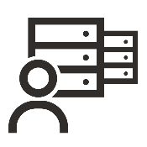
OCI Identity & Access Management (OCI IAM)
Core Functionality
OCI IDENTITY & ACCESS MANAGEMENT (IAM)
!
?
✓
****
Authentication and SSO (Inbound)
Basic Authentication
Federated Logon
Social Logon
Multi-Factor Authentication
Included mobile app
Numerous factor options
Passwordless support
Third-party MFA support
Adaptive Security
Device, location, behavior
Delegated Authentication
Identity Store and Lifecycle Management
Console | CLI | APIs
Custom Schema support
Attribute Synchronization
Auto- and JIT Provisioning
Application Catalog
Provisioning Bridge
Active Directory Bridge
User Self-Service
Enrollment
Consent Management
Password Management
Oracle Cloud IaaS/PaaS Access Policies
Simple Policy Syntax
Access Denied by Default
Group-Based Access
Location Restrictions
Time-Based Restrictions
Supports OCI Compartments
Supports Resource Tagging
Provides Unified IAM
Replicated to All Subscribed OCI Regions
Authentication and SSO (Outbound)
Federated SSO
SAML, OIDC, OAuth
Social Logon
Application Catalog
Generic/Custom Templates
Password Vault | Form-fill
Gateways and Proxies support Hybrid IAM
App Gateway
RADIUS Proxy
Linux PAM Module
Oracle IaaS/PaaS/SaaS
Customer Data Centers
Third-Party IaaS/PaaS/SaaS
OATH OAuth FIDO2 REST APIs SAML OIDC SCIM
15
Copyright © 2024, Oracle and/or its affiliates
Notes:
This is just one way to organize the functionality offered by the OCI IAM service.
Its key capabilities include:
Inbound Authentication and SSO
Identity Store and Lifecycle Management
Oracle Cloud Authentication and Access Policies
Outbound Authentication and SSO
I’ll use the next slide to explain in more detail.
---
Note: This is also covered in the next slide. You may choose to skip this one, depending on your delivery style and audience.

Slide 16
Transitioning to OCI IAM Identity Domains
Notes:
---
8:00

Slide 17

OCI IAM Identity Domains
Oracle is merging IDCS and OCI IAM and keeping the OCI IAM branding.
OCI IAM
(legacy)
IDCS
(legacy)
Brings Existing Value:
Native OCI Service
30+ Geographical Regions
OCI Access Policies
OCI Logging
Brings Existing Value:
Advanced MFA Options
Adaptive Security
Lifecycle Management
Broad Support for 3rd-Party Apps
Consumer IAM
Broad Support for Hybrid IT
OCI IAM
Adds New Value:
Unified IAM for Oracle Cloud and SaaS
Identity Domains Admin Experience
Cross-Regions DR
Notes:
Oracle recently merged Identity Cloud Service (IDCS) into the OCI-native IAM service (OCI IAM).
We standardized on the OCI branding. So, the updated service is called OCI IAM. It’s now a native OCI service available in all (37+) Oracle cloud regions and is better-integrated with other OCI services (Logging, Cloud Guard). It adds all the IAM features and functionality from IDCS natively into OCI – features like strong multi-factor authentication (with numerous authenticator options), context-aware adaptive security, identity lifecycle management (provisioning), SSO to third-party apps, support for hybrid (and on-prem) environments, support for consumer- and developer- IAM use-cases, and more.
As part of this effort, we introduced a new way to manage instances that we’re calling Identity Domains. Identity domains provide an easy way to create and manage IDaaS instances directly from within the OCI console.
This creates a single, unified IAM service addressing numerous identity use-cases (whether its managing access for employees and workforce, partner- or consumer-facing apps, or IAM for custom app development) and with the right backend and the right architecture to serve as our foundation for growth in the IAM space.
---
1:30

Slide 18
OCI IAM Identity Domains Timeline
LA Program
Select OCI tenancies for LA
OCI account conversion
Provide feedback
Code deployed to several regions for testing
Limited Availability Program
(conversion of existing tenancies)
Code ready for US Gov audits
Aug 5 Oct 1 Nov 8 TBD (July) TBD (Aug/Sep) TBD (Oct/Nov)
Begin converting existing tenancies
Identity domains enabled for all existing tenancies
Rolling GA of OCI IAM identity domains in each commercial region
Notes:
This transition to identity domains is happening in two steps:
First, we deploy the updated service to each region. We started this in November and the updated service is now available in all commercial OCI regions. We also expect it to be available in Gov and Defense regions in 2022 with full FedRAMP compliance.
This does not impact existing OCI tenancies or IDCS instances. So, you will not have seen identity domains yet in your environment unless you created a new tenancy after it was available.
Once the service is available in every region, we’ll begin our conversion process. We’ve already started the process with numerous internal tenancies owned by Oracle. Soon, we’ll open up our Limited Availability (LA) Program for customers’ non-production environments. And then we’ll move on to include some production tenancies in the LA. Once we finish the LA program, we’ll begin the broader automated conversion process region-by-region and all remaining tenancies will be converted to the new model.
Tenancy owners will be notified through the OCI console about 1-2 weeks before the upgrade is rolled out and there’s no downtime or re-configuration required.
---
1:00

Slide 19



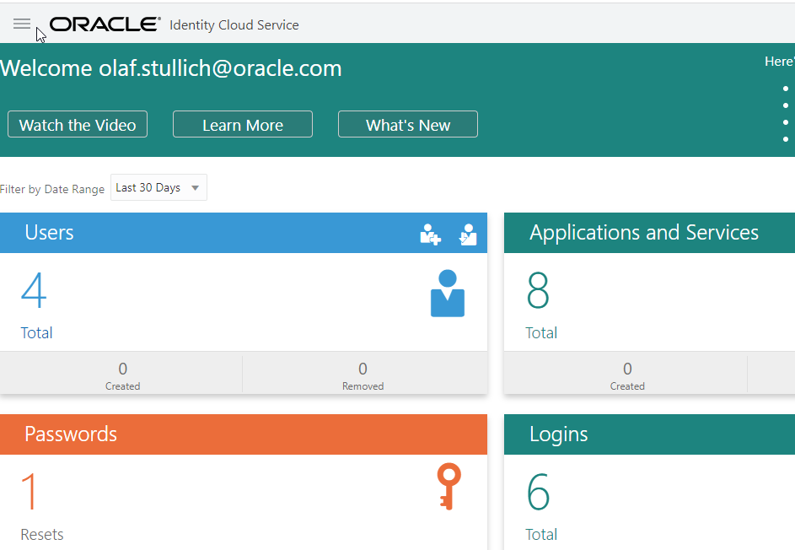
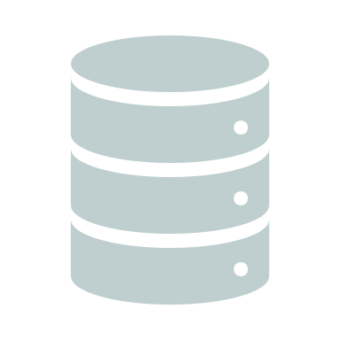
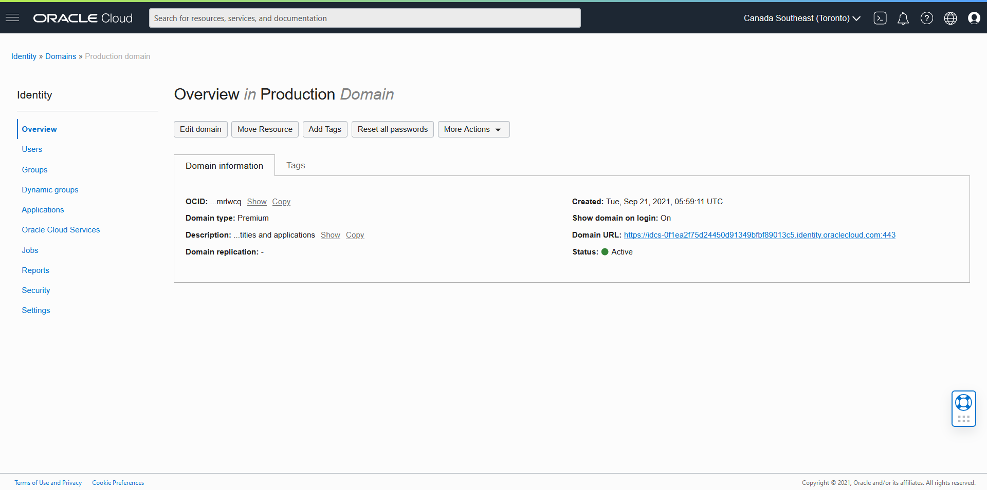
OCI IAM Identity Domains: Impact to existing IDCS instances
Vision Corp
Custom
Logon Screen
APIs
Email
IDCS
Service
Password
Sign In
1.
Metadata that maps instance to OCI tenancy
Forgot Password?
Existing IDCS instance (stripe)
Users, Groups, Applications, Configuration, Security Settings.
APIs
APIs
OCI Tenancy
2.
IDCS Instance Data
IDCS Admin
Console
APIs
Upgrade of OCI Console
in OCI tenancy
Notes:
We expect these conversions to have very little impact on existing tenancies. This slide shows a typical IDCS instance. There’s the IDCS service with a set of APIs. Each instance has a set of data stored in its own database schema including users, groups, apps, and configuration and security settings. And the admin console leverages the service’s APIs for administration.
[click] - Step 1 of this merge is simply to apply metadata to existing instances. This maps each IDCS instance to an OCI tenancy. (This step isn’t required if IDCS is already part of an OCI tenancy but that wasn’t always the case)
[click] - Step 2 is simply to replace the IDCS admin console with an upgrade to the OCI console. The OCI console offers the same set of features and capabilities that were previously available in the IDCS console – it uses the same exact APIs.
Notice that the IDCS backend service and its APIs continue to exist and function as they had before. The existing IDCS instance also continues to exist in the same database with all the same configurations. The instance itself is not changed. We’re not moving data or migrating anything on the backend. We’re just attaching each instance to an OCI account and upgrading the console experience.
There’s no impact or changes to SDKs, APIs, or service URLs. In most cases, your end users won’t even know that a change happened.
---
1:30

Slide 20
Account Conversions for IDCS
Before
After
External IdP
External IdP
IDCS
OCI Account
OCI Account w/ identity domains
Local Accounts
Default Domain
Primordial Instance Foundation
IDCS Federation
OracleIdentityCloudService
Type: IDCS-Foundation
Secondary Instance 1 Standard - Enterprise
Secondary Domain 1
Type: IDCS-Standard-Ent.
Secondary Instance 2 Standard - Consumer
Secondary Domain 2
Type: IDCS-Standard-Con.
Notes:
This is a typical BEFORE state where we have an OCI account with local users and groups, and there’s an IDCS instance which is federated into the OCI account.
[click] – First, we’re maintaining any external federations directly to OCI IAM. So, for example, if you have Azure AD federated into OCI, that continues to work as expected.
[click] – Local OCI accounts will become a special identity domain in the OCI tenancy called the Default identity domain.
[click] – The primordial IDCS instance (the one that was created at account provisioning time) that is federated to OCI becomes a domain called OracleIdentityCloudService.
[click] – All other IDCS instances also become identity domains.
All domains that were previously IDCS instances will maintain their existing license type, features, limits, and configurations. In the console, the domain type will match the previous IDCS license. We were very intentional to avoid any unwanted changes. So, we’re not automating or forcing a change to any of the new domain types.
---
1:00

Slide 21
OCI IAM Identity Domain Types
Free (Included) | Oracle Apps (Included) | Oracle Apps Premium ($0.25/user/mo.) | External ($0.016/user/mo.) | Premium ($3.20/user/mo.)
Manage access to OCI resources. | Provisioned by Oracle services to manage access to subscribed Oracle services. | Adds hybrid IAM (proxies, gateways, bridges) for use with on-prem or OCI-hosted Oracle applications. | Full IAM feature set for non-employee use-cases, CIAM, and custom app developers. | Full IAM feature set for workforce use-cases; manage access across hybrid IT.
Key Limit: 2000 users | Key Limit: Must be provisioned by an Oracle service. | Key Limit: Supports only six (6) non-Oracle Apps | Key Limit: For non-employees. No hybrid IAM support. | Key Limit: None
Included features Basic authentication, federation, and SSO MFA and adaptive sec. User and group mgmt. User self-service All security policies: IdP, passwords, sign-on, etc. Dynamic groups Schema extensions Delegated admin AD bridge inbound sync PIV/CAC support Basic branding OCI IAM policies Audit and reporting | Feature restrictions No bridges, proxies, gateways (except AD) No AD bidirectional No delegated AuthN No self-registration No hosted screens Limit (2) external apps - SSO and LCM Limit (3) external IdPs | Additional features All bridges, proxies, gateways (limited to Oracle targets): App Gateway Provisioning Bridge EBS Asserter RADIUS Proxy for Oracle Database Linux PAM AD bidirectional Delegated AuthN Self-registration Hosted screens Limit (6) external apps - SSO and LCM Unlimited external IdPs | Feature restrictions No bridges, proxies, gateways No AD bridge No identity lifecycle management or provisioning No OCI IAM policies Note: These are typically not required in CIAM scenarios. | All features No restrictions
Notes:
I want to provide a high-level understanding of identity domain types, but please refer to the official docs for full information on what’s included in each domain type and the related limits.
Let’s start with type: Free
Free: Every OCI account has a Default domain which is of type Free and the ability to create an additional Free domain. The intent of providing Free identity domains is to allow customers of OCI to manage access to their cloud resources. These are relatively full-featured with various authentication options including MFA and Adaptive Security. But there’s a limit of 2000 users so these aren’t ideal for setting up enterprise workforce Access Management.
Oracle Apps: You may want to ignore this domain type. The reason I say that is that you can’t elect to use an Oracle Apps domain. It’s a reserved domain type for use by Oracle service teams. They can provision an Oracle Apps domain for you, when you purchase their service. It’s a way for Oracle to offer strong IAM features at no additional cost to the customer. But the service team has to register with the IAM service and agree to the chargeback costs. We’re actively working with various service teams across Oracle Cloud and SaaS and many will be leveraging these domains in the coming months. But again, they’re not an option for you unless a service team creates it on your behalf.
For both of those domain types, there are some feature restrictions. For example, you don’t get the bridges, proxies, and gateways that enable IAM for hybrid-cloud environments. And there’s a limit of two non-Oracle apps. These domain types are both intended to help you manage access to Oracle Cloud services. If you want more than what these allow, you can upgrade. And that brings me to:
[click] – Oracle Apps Premium: Now this is an interesting one. Priced at only $0.25/user/mo., this domain type provides a robust feature set – including the bridges, proxies, and gateways for on-prem apps – but it’s intended for use only with Oracle applications. That includes on-prem apps, databases, E-Business Suite, Peoplesoft – if it’s a commercial Oracle product, you can use this domain type. We do allow up to six non-Oracle apps as well. Obviously, most of us have well more than six non-Oracle applications. But if your model is to use another IAM solution for most apps and you want to use OCI IAM for your Oracle footprint, this domain type may be the right way to go.
And the last two are pretty simple.
[click] – External domains provide the right feature set for Consumer IAM or app developers with consumer or citizen audiences. It provides social logon, self-registration, terms-of-use consent, and other consumer-facing features. But it doesn’t support hybrid IAM. You can’t integrate with Active Directory or on-prem apps.
[click] – Premium domains provide the full feature set with no feature restrictions.
So, hopefully, that helps you understand the five identity domain types and what to expect for each.
---
https://docs.oracle.com/en-us/iaas/Content/Identity/sku/overview.htm#overview
---
3:00

Slide 22
OCI IAM Features and Functionality
Oracle Cloud Infrastructure Identity & Access Management
Notes:
---
Note: These slides don’t need to be part of a general introduction to the OCI IAM service but can be used to dive deeper into specific topics or to help field Q&A.

Slide 23
Inbound Authentication and SSO
Strong, flexible authentication options
Supports basic authentication via username and password
Supports common federation protocols and social logon with multiple identity providers SAML, OpenID Connect, OAuth
Numerous options for Multi-Factor Authentication (MFA) Included mobile app supports passwordless logon
Adaptive security evaluates risk in real-time based on context and session awareness
Delegated Authentication to Active Directory
Leverage open standards for easy configuration of inbound SSO.
Federated SSO
Native support for popular social Identity Providers.
Social
Logon
Numerous options for MFA including a mobile app, Email, SMS, KBA, third-party and FIDO2 authenticators.
MFA
!
Evaluates risk based on several factors including device, network, location, and user behavior.
?
✓
Adaptive
Security
Enables delegated authentication to Active Directory (leverage AD credentials).
Active Directory
Bridge

Slide 24
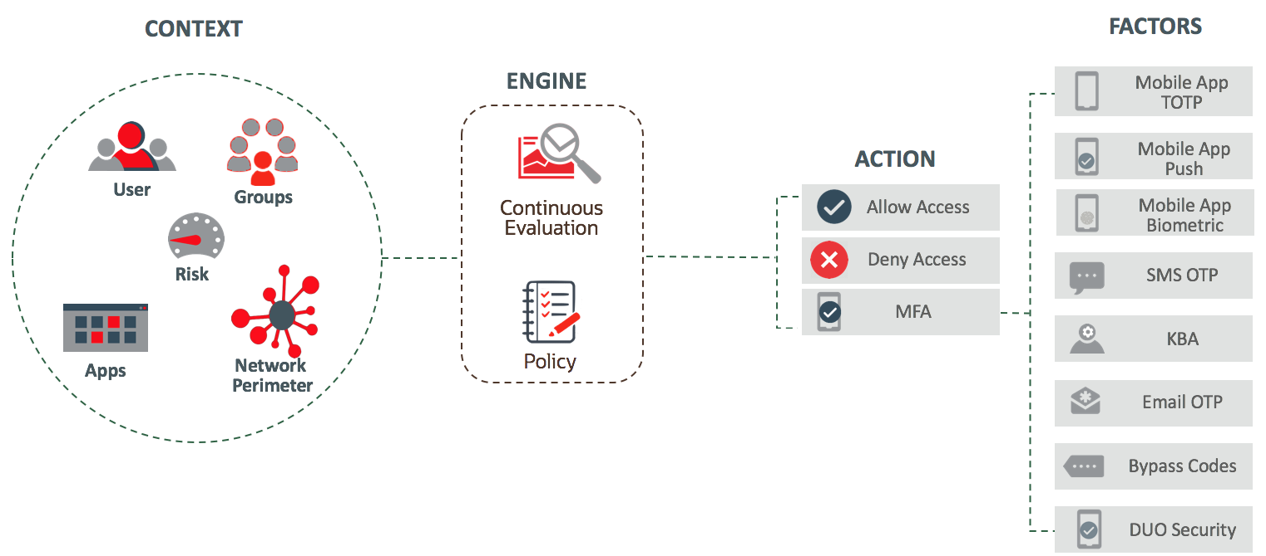









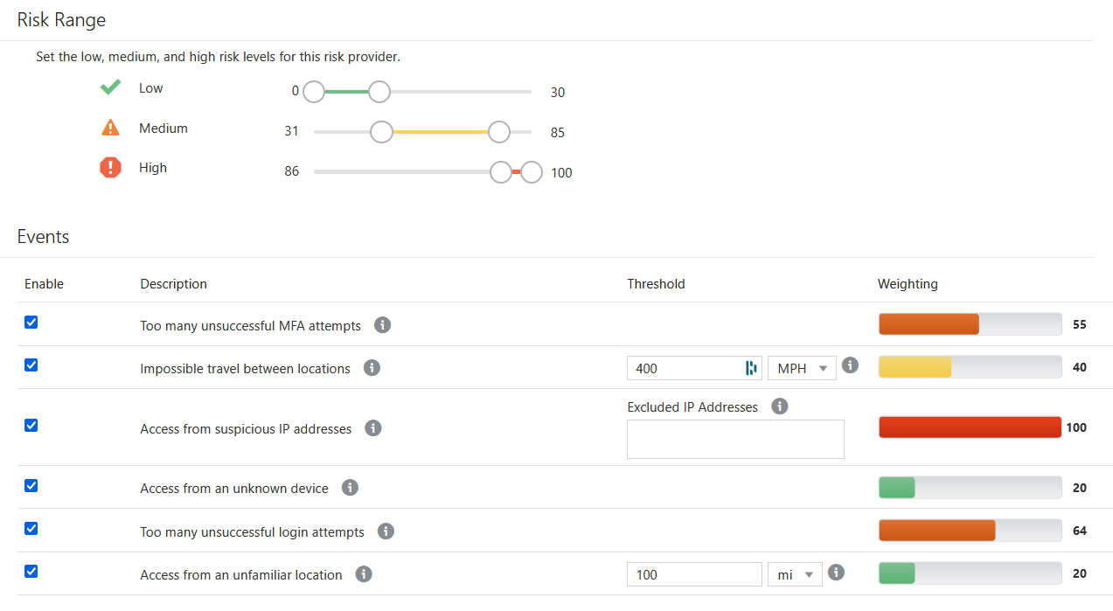
Inbound Authentication and SSO
Adaptive Security
Sign-On Policies and Entitlements
Multi-Factor Authentication
Device Trust
Group Memberships
Failed Logons
Anomalous Behavior
Access Velocity
Impossible Travel
Device
Groups
User
Behavior
Network
Geographic Location
IP Reputation
Apps
Network
App Risk
App Policies
External
Feeds
External Risk Sources
Threat Intelligence
CASB
Risk Scoring
FIDO2

Slide 25
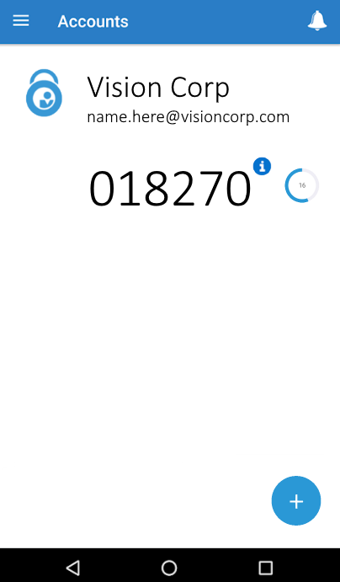
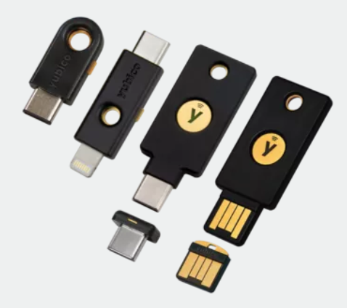
Inbound Authentication and SSO
Multi-Factor Authentication (MFA) Factors
FIDO2 Authenticators
Voice Phone Call
Mobile App Passcode or Notification
SMS Text
Security Questions
Email
Bypass Code
Third-Party Authenticators Duo, Yubico, etc.
Trusted Devices

Slide 26
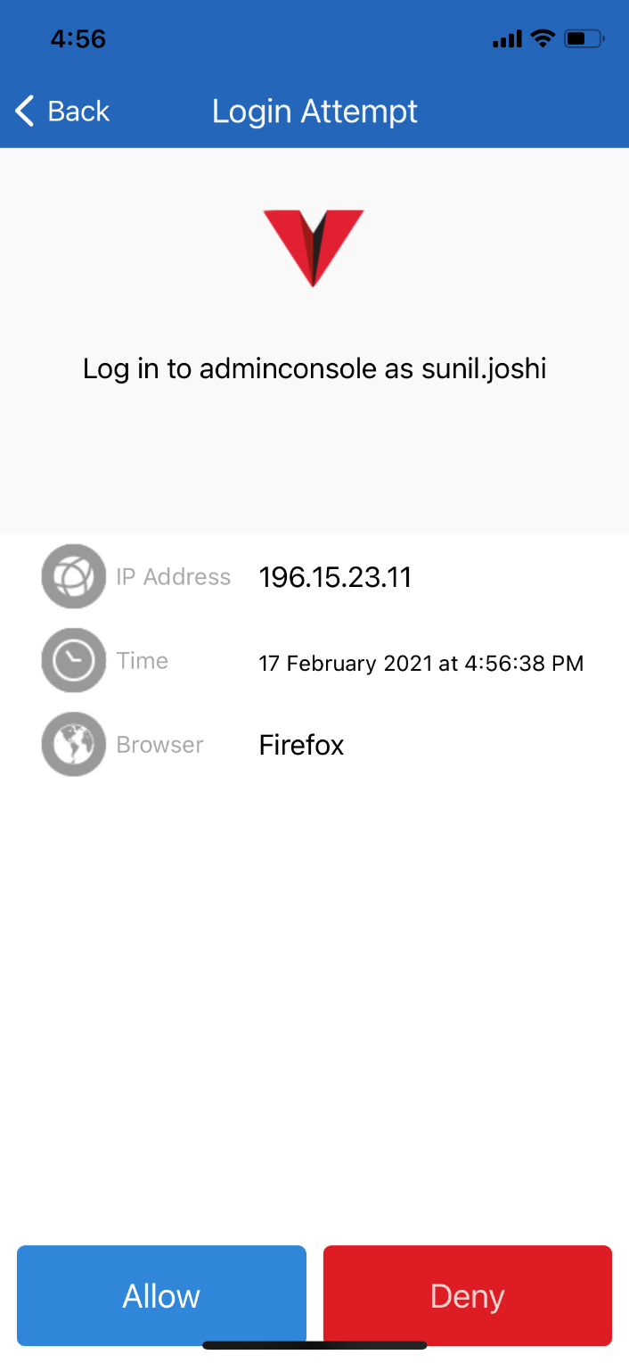
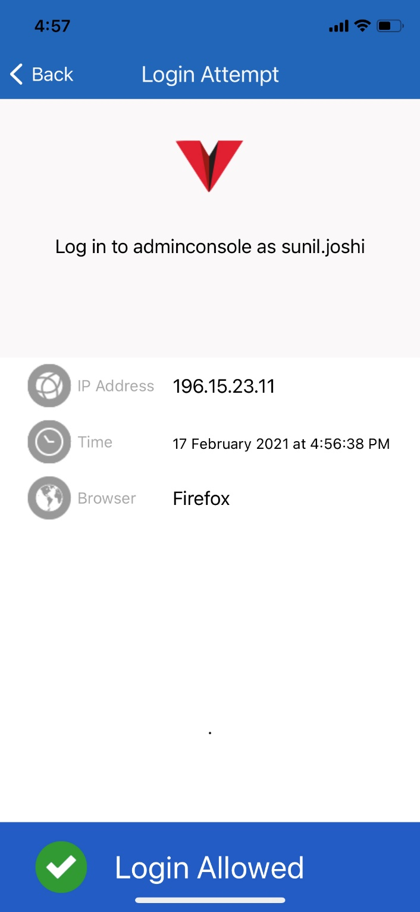
Inbound Authentication and SSO
Passwordless Authentication
User creates profile at first logon
User enrolls device and MFA app
When user attempts to authenticate, they can logon via a push notification in the MFA app – no password required!

Slide 27
Identity Store and User Lifecycle Management
Automate user lifecycle management
Manage via console, CLI, APIs, or automation
Custom schema support
Auto- and Just-in-Time (JIT) provisioning
Auto-manage entitlements for Oracle apps and databases
User self-service enrollment and management of profile, password, and terms-of-use consent
Support for virtually any SaaS, cloud-hosted, or on-prem apps
Generic SCIM support enables integration with most apps
400+ SaaS apps natively supported via partner gateways
Manage users manually via console, CLI, or APIs. Bulk imports available with full or incremental updates.
User & Access
Management
Pre-configured automation of onboarding, offboarding, and synchronization flows for numerous apps. Generic templates support virtually any other apps.
App Catalog
Provisioning to/from virtually unlimited apps hosted on-prem or in the cloud using ICF connectors. Supports heavy customization as-needed. Supports High Availability.
Provisioning
Bridge
Synchronize AD Users and leverage AD Security Groups to manage IAM permissions.
Active Directory
Bridge

Slide 28
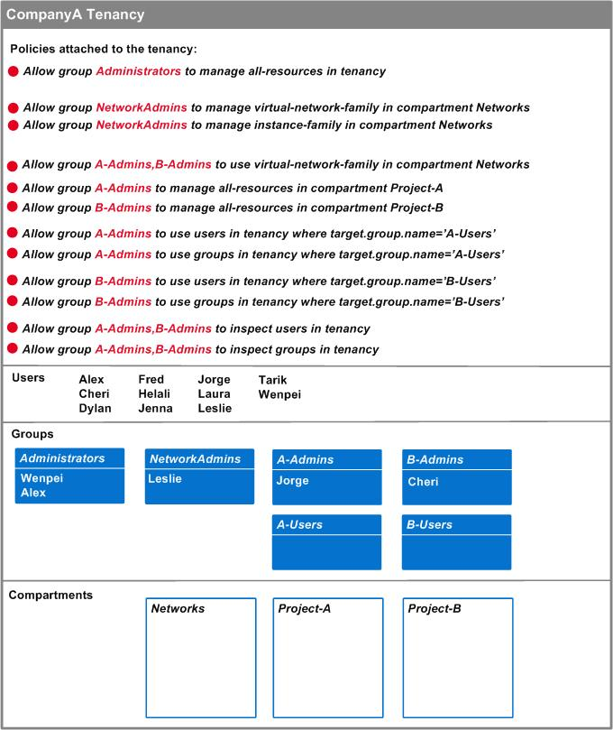
OCI IaaS and PaaS IAM Policies
Control who has access to OCI cloud resources
Easy to understand policy syntax
Authentication policy can restrict by IP address
Group-based entitlement management
Compartments provide security boundaries inside of OCI tenancies
Time- and Location-based restrictions
IAM auto-replication to subscribed regions
Supports Tagging for groups and/or resources
Notes:
For more information:
https://docs.oracle.com/en-us/iaas/Content/Identity/Concepts/overview.htm
https://docs.oracle.com/en-us/iaas/Content/Identity/Concepts/policies.htm#How_Policies_Work
https://docs.oracle.com/en-us/iaas/Content/Identity/Concepts/commonpolicies.htm#top

Slide 29
Outbound Authentication and SSO
Easy Single Sign On (SSO) experience across extended, hybrid enterprises
Support common federation protocols SAML, OpenID Connect, OAuth
App catalog provides out-of-the-box integrations with 1000+ apps
Generic and custom templates support any other apps that support federation protocols
Password vaulting (form-fill) for apps that don’t support federation protocols
Just-in-Time provisioning to target applications
Gateways and Proxies support SSO to hybrid environments.
Leverage open standards for easy configuration.
Federated SSO
Pre-configured SSO and Just-in-Time provisioning for numerous apps.
App Catalog
SSO to virtually unlimited apps hosted on-prem or in the cloud that may not support open standards.
App
Gateway
Support SSO to VPN clients and Oracle Databases.
RADIUS
Proxy
Support SSO to Linux hosts running on OCI
Linux PAM
Module

Slide 30
OCI IAM Best Practices
Create a security model (tenancy, compartments, tagging) before adding users, resources.
Enforce Least Privilege; gradually add permissions as needed.
Do not use OCI default Administrator or Administrators group after initial account setup.
Leverage situational permissions (time- or location-based) where possible.
Leverage compartments and tagging to simplify access management. Align your OCI compartment design with your department or project structures.
Use instance principals and dynamic groups to manage machine access to APIs.
Enforce multi-factor authentication and leverage adaptive security whenever possible.
Use different identity domains for each user population.
Whitepaper: Best practices for identities and authorization.

Slide 31
OCI IAM High Availability (HA) and Disaster Recovery (DR)
OCI Identity and Access Management
Notes:
---
5:00

Slide 32





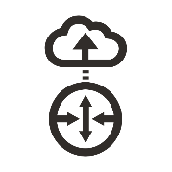


OCI Identity & Access Management (OCI IAM)
High Availability Architecture
Cross-Region Disaster Recovery
OCI Region (Primary)
OCI Region (Secondary)
Load
Balancer
Load
Balancer
Availability Domain 1
Availability Domain 2 (or Fault Domain)
Availability Domain 1
VCN
Subnet A
Subnet C
VCN
Subnet A
High
Availability
OCI IAM
OCI IAM
OCI IAM
HTTPS
Security
Lists
Security
Lists
OCI DNS
Internet Gateway
Subnet B
Subnet D
Internet Gateway
Subnet B
Primary
Database
Standby
Database
Exadata
ADG Replication
Exadata
Automatic
Cross-Region Replication for DR
Exadata
Security
Lists
Security
Lists
32
Copyright © 2024, Oracle and/or its affiliates. For authorized use only. Do not distribute.
Diagram is representative and for discussion only.
Notes:
Obviously, OCI IAM is delivered as a service so you don’t need to worry about the backend architecture or the infrastructure it runs on, but this slide is just to give you a little insight into how the service is designed. This is somewhat of a high-level representation – it’s not a technical blueprint, some of the details may be omitted, but hopefully it gives you an understanding of the basics.
OCI IAM is accessible from the public internet and internal OCI networks.
Only the load-balancers are exposed to the public and each layer of the architecture (Web-Tier, App-Tier, Cache-Tier, Data-Tier) has its own private subnets. Access in and out of the subnets is controlled by OCI security lists. And the service itself is deployed on an isolated VCN network.
Inside each region, we have either multiple Availability Domains or Fault Domains (in single-AD regions). They act the same way, but Fault Domains are closer together than Availability Domains. ADs are in separate buildings while Fault Domains are different racks in the same building.
IAM is deployed with redundant installations within each region that provide high availability (at least one additional service and data tier in each AD/FDs). The service is automatically replicated to all OCI regions where an OCI resource subscription has been purchased for the customer tenancy. But don’t be confused by that. Replication is not HA or DR. Access to additional regions requires the home region to be available. I’ll talk more about replication in a moment.
[click] – In early 2022, we deployed cross-region Disaster Recovery to many regions. Our docs lay this out (link below), but basically, if your country has more than one region – or if laws in your country generally allow data to move to another specific region (as is the case for Germany and Netherlands), then we have implemented cross-region DR. In some countries, there’s only one region and no suitable DR region so DR is not yet enabled in those regions. Again, the details are in the docs under “Managing Identity Domains”. When enabled, the data for your instance is replicated to the paired region.
[click] – In the unlikely event that the entire OCI home region becomes unavailable, we can route traffic to the secondary region to speed the service recovery and retain as much data as possible.
If this DR failover happens, the secondary region becomes the home region. It supports authentication, and full administration; it’s not read-only.
This is essentially service recovery – in other words: It doesn’t prevent the failure. There may be some down time. And there may be some data loss. But DR allows us to recover the service if something catastrophic happens in the primary region.
We are also exploring potential designs for cross-region HA which will enable faster failover to a secondary region with full capabilities for sign-on and administration. It’s based on replication so customers will be able to choose the secondary region and test your own HA/DR process. Specific dates are still to be determined but we have some pretty good ideas of what we want to build.
This DR that’s already implemented applies to IDCS instances as well. So, you do not have to wait for your tenancy to have identity domains to get cross-region DR. If you’re in Australia, Canada, Japan, South Korea, U.K., U.S., and several others, you already have it.
---
https://docs.oracle.com/en-us/iaas/Content/Identity/domains/overview.htm#disaster_recovery_and_domains
---
3:30

Slide 33

OCI IAM Replication
OCI Account
Region 1
Region 2
OCI IAM
Resource 1
OCI IAM
Resource 1
Resource 2
Resource 2
Notes:
OCI IAM replication often gets confused with DR or HA. So, I just wanted to touch on this.
[click] – Obviously, OCI IAM is required to authenticate and authorize access to OCI resources.
[click] – If you subscribe your tenancy to additional OCI regions, you need OCI IAM presence to facilitate access to the resources in the secondary region. This is what we call OCI IAM replication. This is not DR or HA. If the primary region is unavailable, you can’t authenticate directly to the secondary region. And the IAM instance in the second region is read-only; all changes have to be made in the primary region.
So, replication is important and serves a vital function. But it’s not HA or DR. Having said that, as I mentioned on the last slide, we’re looking at leveraging this replication capability to enable cross-region HA with full functionality (authentication and read/write). So, that’s what we’re expecting to be the next generation of HA/DR. And with that approach, you’ll be able to choose the secondary region and to test your HA/DR processes, on your own schedule, because it’s applied per-tenancy.
---
1:30

Slide 34
Common Hybrid IAM Use-Cases
OCI Identity and Access Management

Slide 35




OCI IAM Provisioning Bridge
Oracle Cloud Infrastructure or On-premises
OCI IAM
Provisioning
Provisioning Bridge
ICF
ICF
ICF
Enterprise Apps

Slide 36


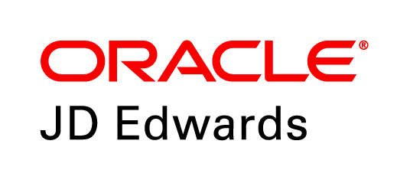
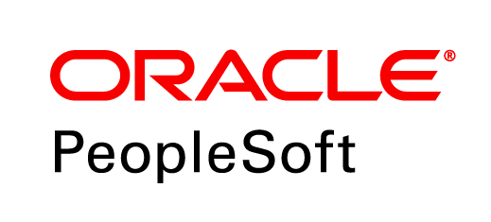
OCI IAM App Gateway
Oracle Cloud Infrastructure or On-premises
OCI IAM
SSO
Supports HTTP Headers
App Gateway
Enterprise Apps

Slide 37
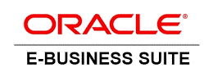
OCI IAM Support for E-Business Suite (EBS)
Oracle Cloud Infrastructure or On-premises
SSO
OCI IAM
EBS Asserter
SSO
Provisioning
Supports Federated SSO!
Provisioning Bridge
OAM
OID
Supports Application Roles!
Notes:
If you’re thinking of moving your EBS workload to the cloud (or just modernizing on-prem),
[click] – One option is simply to move the entire stack to the cloud. You can certainly host all of these components on OCI and the IAM Suite Dev team is making it easier for customers who want to run OAM or other IAM software components on OCI.
[click] – But a lot of customers want to simplify their infrastructure and to remove the required OAM and OID components that EBS typically requires for SSO.
So, another option is to
[click] – Replace the requirements for OAM and OUD or OID with the IDCS EBS Asserter. This provides a simpler architecture that supports SSO to EBS and it’s been very popular with customers.
This scenario also enables federation from external identity providers like Okta or Microsoft Azure AD for SSO to EBS whether it’s on-prem or in the cloud.
[click] – And OCI IAM also supports Provisioning to/from EBS, whether hosted in the cloud or on-prem, via the Provisioning Bridge component. And this approach supports managing entitlements within EBS via the concept of Application Roles.

Slide 38
Federation from Azure AD
OCI Identity and Access Management

Slide 39
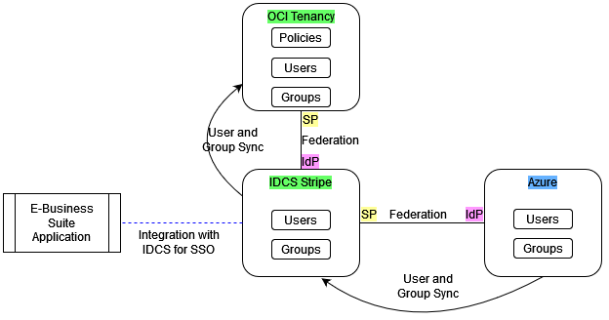
Azure AD Federation
via IDCS (Before)
Notes:
Q: What happens to existing group mappings from Azure AD through IDCS to OCI IAM?
A common customer use-case is to leverage Azure AD for authentication with Single Sign On (SSO) into OCI IAM via IDCS. Here’s how it works:
The customer leverages Azure AD for authentication and has configured federated SSO from Azure AD into the Oracle IDCS instance that came with their OCI account (aka the primordial IDCS).
They have also configured federation from the primordial IDCS into OCI IAM and mapped group(s) from Azure AD into OCI. They may use this process, for example, to populate the OCI Administrators group.
The customer may have written OCI policies that reference OCI IAM groups that are populated from Azure AD.
They may have also configured Single Sign-on into Oracle E-Business Suite or Oracle ERP and mapped other group(s) from Azure AD into the applications.

Slide 40
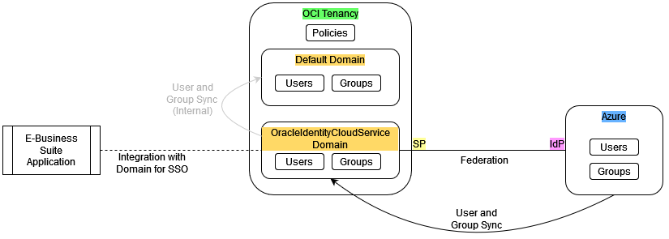
Azure AD Federation
Via OCI IAM identity domains (After)
Notes:
So, when IDCS instances and the local IAM users and groups become OCI IAM identity domains, what will happen to this configuration? Will it continue to function as expected? The simple answer is yes.
When identity domains are introduced into the account, local users and groups will be placed in a special identity domain named Default, which is of type Free. The primordial IDCS instance becomes an identity domain named OracleIdentityCloudService. As IDCS instances become identity domains, they maintain their existing license types, feature sets, and limits. So, if the primordial instance has a license type of IDCS Foundation, the OracleIdentityCloudService domain will have a type of IDCS-Foundation.
Because the IDCS instance is now represented as an identity domain in the IAM service, there is no need for SSO federation between the two identity domains. Since OCI access policies may have already been written without a domain qualifier, those existing policies will reference users and groups that now exist in the Default domain. The process to deploy identity domains is designed to maintain group mappings and user/group synchronization between the OracleIdentityCloudService and Default domains. So pre-existing users and groups in the Default domain will continue to be auto-populated from OracleIdentityCloudService, which in turn are synchronized from Azure AD. Any pre-existing OCI policies will therefore continue to function by referencing the users/groups in the Default domain.
To be clear, in this scenario, both the Default domain and the OracleIdentityCloudService domain will have the same set of users and groups populated, which originate from Azure AD. Customers will have the option to remove the federation between the OracleIdentityCloudService and Default domains, keep their federation from Azure AD to OracleIdentityCloudService, and update their IAM policy statements to reference the OracleIdentityCloudService domain. Another option would be to reconfigure Azure AD to federate directly to the Default domain bypassing the OracleIdentityCloudService domain, but we prefer and recommend the former approach (update policies to reference OracleIdentityCloudService).

Slide 41
Before
No longer necessary
After
Remain in place
Remain in place

Slide 42
OCI IAM Vision and Roadmap
OCI Identity and Access Management
Notes:
---
5:00

Slide 43
OCI
Identity and Access Management
Oracle Cloud Applications
Oracle Cloud Infrastructure
Complete suite of integrated applications
Secure, high-performance platform for all your workloads
43
Copyright © 2024, Oracle and/or its affiliates
Notes:
I talked earlier about the importance of OCI IAM to Oracle as a whole. It’s critical infrastructure for Oracle Cloud and SaaS applications. This means we will continue to innovate, grow, and to strengthen the service across availability, performance, features, and intelligence.
---
0:30

Slide 44
OCI IAM Vision
Simplicity, Visibility, and Automation
Enterprise Identity & Access Mgmt. for complex, hybrid IT environments
High value proposition with more included features
Unified IDaaS for access management, governance, and privileged access
Robust set of risk indicators and analytics
Far reach of control across hybrid, heterogeneous IT
Enhanced ML and analytics via OCI service integrations
Developer-focused IAM engine for custom and consumer-facing applications
Integrated experience via APEX and Visual Builder
Shared fabric via APIs with hooks across OCI, security services and apps exposing user, session, app, platform, and access pattern data
Leverage automation for easier integrations
Enhanced risk analytics for CIAM use-cases
Access control plane for Oracle Cloud and SaaS applications
Zero-touch IAM integrations with Oracle apps for access, roles, and lifecycle mgmt.
Deep security and risk visibility, insights for OCI and Oracle apps
Improved automation for service operations
Auto-tuning security policies based on risk
Shared security models
Notes:
Our high-level vision for OCI IAM, as I mentioned earlier, focuses on key themes of Simplicity, Visibility, and improved Automation.
For Enterprise IAM Use-Cases:
We want to continue offering a high value proposition. Our cost is very low compared to competitors for the same functionality.
We’re also introducing risk, governance, and PAM-related features so we’ll have a converged identity platform with all the functionality customers need in a single unified IDaaS service.
We’ll continue adding new analytics capabilities and risk indicators, which will help automate the remediation of access-related risk.
And we want to continue to expand the set of applications and targets that are pre-integrated with the service.
For Consumer and Developer IAM Use-Cases:
We want to more deeply embed into developer tools.
We’re working on establishing a shared fabric with APIs and hooks across various services to simplify the development process.
And we want to expand automation and analytics in ways that are specifically beneficial for these use-cases.
For managing access to Oracle Cloud and SaaS:
We want to get to a point where there’s zero-touch integrations. If you subscribe to an Oracle app, like ERP or HCM, you shouldn’t have to configure a connector or setup federation. It should be done automatically when you subscribe.
We also want deeper visibility into OCI resources and Oracle applications. We understand the security models and business roles, so these should be natively exposed in our console to foster a full view of access and risk that extends down into those critical business applications.
We want security policies to auto-tune based on risk identified in the environment – either based on configuration, user behavior, or other factors.
And ultimately, we want to push our application teams to get to a shared security model so that business roles and access entitlements are uniformly understood across apps. Obviously, this is a bigger project that involves many dev teams, but it’s a goal worth pursuing.
---
2:30
* Specific dates and deliverables are TBD.

Slide 45
Why choose Oracle for IDaaS?
Strong Value
Strong value for cost
Improved user experience via better performance and scale as a native OCI service
Peace of mind that OCI IAM will continue to incorporate latest and best approaches
Presence across 30+ cloud regions; meets data residency requirements
World-class, global support
Depth for Oracle Targets
Reduced effort and easier integrations for EBS, Fusion Apps, Oracle Databases, etc.
Simplified entitlement management via App Roles
Reduced management overhead via strong hybrid support for apps running on-premises, hosted on OCI, or SaaS
Migration expertise, support, and discounts moving from OAM
IAM Experience
Oracle has led in IAM for past two decades; working with the world’s largest, most complex organizations
Strong hybrid IT support supporting on-prem apps, App Gateway, Provisioning Bridge, AD Bridge, RADIUS, Linux, etc.
Powerful provisioning to on-prem via ICF connectors.
Easier to get support from strong SI partner ecosystem.
Notes:
We understand that you have many options for Identity-as-a-Service (IDaaS). In general, a lot of IDaaS functionality is becoming standard. SAML is SAML. And most IDaaS solutions allow you to authenticate with strong methods, validate access against security policies, and facilitate sign-on to target apps. So, why would you choose Oracle for IDaaS?
[click] - First, OCI IAM offers a very strong value proposition. Put simply, you get more for your money. We offer a strong feature set that’s all-inclusive for the use-case. If you’re enabling workforce access to business applications, you get everything you need for a single, low-cost license including MFA, adaptive security, automated provisioning and deprovisioning, the use of the proxies, bridges, and gateways, etc. – with no additional costs. Other vendors may price a-la-carte which can get very expensive over time.
If geography and data residency requirements matter to you, our presence across the globe is another strong advantage. We can meet local data residency requirements in many geographies around the world with over 35 cloud regions and counting. And our support team operates 24x7 following the sun and typically offers support in local languages.
The service is natively part of OCI, which is one of the world’s top cloud platforms. So, you get strong performance and scale and plenty of room for growth. The Oracle cloud is a platform so in addition to Identity, you can leverage WAF, database, secrets manager, certificates, and a robust application development platform.
[click] - We also have broader depth for Oracle applications. If you’re running Oracle HCM or ERP, E-Busines Suite, or Oracle Database, we have advantages in our ability to support these targets. For example, the EBS Asserter facilitates SSO to EBS without the typically-required software IAM components (OAM and Oracle Directory). And we support application roles giving you management control of permissions inside of the application. Most IAM solutions stop at the binary allow/deny into an application. With App Roles, you can manage or automate what privileges people will have after they authenticate.
[click] – And our experience counts too. As I mentioned up front, we’ve been leaders in the IAM space since the beginning. We work with many of the world’s largest, most complex organizations. We weren’t built to ONLY address the needs of the mid-market. Many of our customers run their businesses on Oracle. We have a partnership with our customers. So, it’s important that we’re able to tackle the big, difficult problems of IAM and we do that every day – whether you work with Oracle service delivery teams, have Oracle support your own efforts, or work with any of our global System Integration partners, you’ll get the help you need to address whatever requirements or complexity that you encounter.
---
2:00

Slide 46










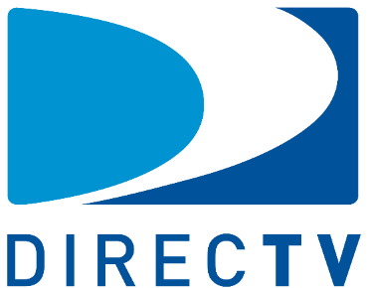





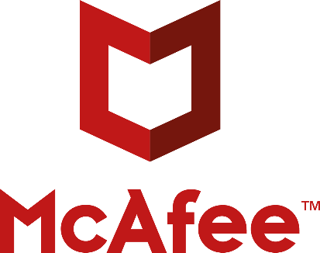




Customers Across Verticals and Geographies
Notes:
A few select customers:
The University of Colorado has over 300,000 users and 100+ app integrations.
The City and County of San Francisco provides SSO across over 50 Government agencies and reported a 6x lower cost as compared to the competitors they evaluated.
The Los Angeles School district is one of the country’s largest school systems.
Loblaw is a chain of grocery stores, pharmacies, and financial services across Canada with a robust loyalty program powered by OCI IAM. They manage access to their systems for more than half of all Canadian citizens.
This is just a representative set. Among our customers, we have universities, cities, retail companies, energy utilities, governments, tech companies, and more.

Slide 47
Thank you
Alexandre Fagundes
Cloud Architect | Oracle Latin America

Slide 49
Appendix Content
OCI Identity and Access Management
Notes:
---
Note: Use these slides to dive deeper into specific topics or to help field Q&A.

Slide 50



X.509 | Common Access Card (CAC) | Personal Identity Verification (PIV)
Authority
(Identity Provider)
OCI IAM
Signing Certificate
(Private Key)
OCSP Validation
User Enrollment
X.509 Identity Provider
User Credential (CAC/PIV)
(Federation)
Digital Certificate
Signing Certificate
(Public Key)
Notes:
---
From the docs:
A digital certificate is like an electronic passport that helps a person, computer, or organization to exchange information securely over the internet using public key cryptography. A digital certificate may be referred to as a public key certificate.
Just like a passport, a digital certificate provides identifying information, is forgery resistant, and can be verified because it is issued by an official, trusted agency. The certificate can contain the name of the certificate holder, a serial number, expiration dates, a copy of the certificate holder's public key (used for encrypting messages and verifying digital signatures) and the digital signature of the certificate-issuing authority (CA) so that a recipient can verify that the certificate is real.
In order to verify external identity providers’ signatures, the service provider stores copies of their signing certificates. When the service provider receives a signed message from an identity provider, before the stored certificate is used to verify the signature, the certificate must be verified as valid. Certificate validation includes verifying that the certificate has not expired. After the certificate has been validated, the certificate is used to verify the signature on the message.
In order for this operation to succeed, the public key embedded in the certificate must match the private key that the identity provider used to sign the message.
Source:
https://docs.oracle.com/en-us/iaas/Content/Identity/identityproviders/manage-identity-providers.htm#usingconsole

Slide 51
Using Credentials Across Multiple Tenancies
Today, you can configure any Identity Provider (inc. OCI IAM) to federate to multiple OCI tenancies.
OCI IAM is planning for improved use of credentials across multiple OCI tenancies. This is part of a broader effort to create a single Oracle identity for use across all Oracle services. Timing TBD.
Design approaches under consideration include:
Associate DNS domain names with an identity domain making it authoritative for that DNS domain name suffix. Users who authenticate with matching credentials see available resources.
Authoritative identity domains with links to user identities in non-authoritative identity domains which can exist in other tenancies. Organizations cloud leverage authoritative identity domains making it easier to manage users across parent and child tenancies.

